Slide 1
Safe Zone
Lo-Fi & Hi-Fi Prototype

Slide 2
Lo-Fi Prototype
For this project, we decided to create sketches as our lo-fi prototype.
We looked at the sketches and discussed what we like and dislike about the basic features in the sketches.
“Live” Demonstration
We had one person walk everyone through the process of using the application through the sketches and we discussed how to make the process easier for the hi-fi prototype

Slide 3
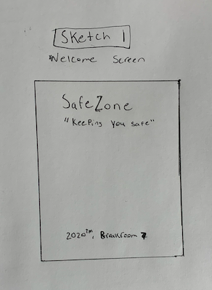
Lo-Fi Prototype: Sketch
What we like about this sketch:
Space for a “loading” animation
The “Welcome Screen” is not too busy so that the users will less likely to experience eye-stimulation
What we fixed:
Implemented a logo, reduce white space
Made it more aesthetically pleasing
Added a message at the bottom for users to remember to practice important preventive measures in spreading the virus

Slide 4
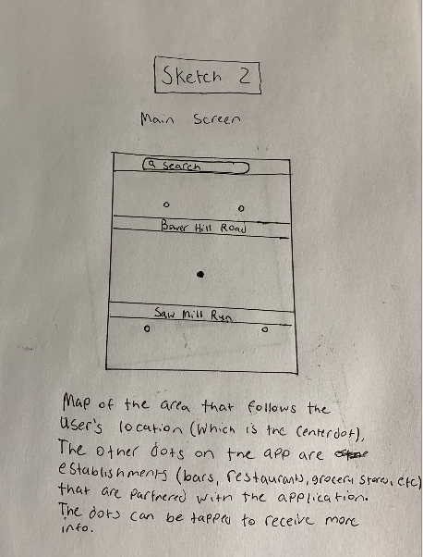
Lo-Fi Prototype: Sketch
What we like about this sketch:
Map interface with tracking capabilities
Search bar for specific restaurants
What we fixed:
Used different colors for the dots on the map to indicate the capacity of the restaurants
Green - less than 50% full
Yellow - more than 50% full
Red - full
Blue - Users
Make it more convenient and easier for users to look through places
Added a “suggestions tab” and a “help tab” on the bottom left and right corners of the map.
Added the user profile on the right of the search bar

Slide 5
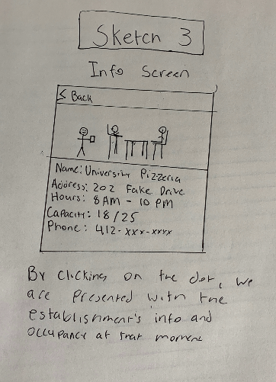
Lo-Fi Prototype: Sketch
What we like about this sketch:
A lot of important information provided for users
Convenience: One tap and it will give the users all the information
Live Updates: pictures and feedback
What we fixed:
Provided clear and organized information for the users on the establishment
Implemented two buttons that show the restaurant’s COVID-19 protocols and user reviews of the business

Slide 6

Hi-Fi Prototype
For the Hi-Fi prototype, we decided to use Adobe XD to design the app.
We recorded a demonstration video of the app and discussed to see if there is anything we can improve.
Step-by-step, we evaluated the applications feature and the user process of navigating and made observations as a group
We’ve submitted the Adobe XD file of the Hi-Fi prototype in the submission zip file
Titled “Final Project (Hi-Fi Prototype).xd”

Slide 7
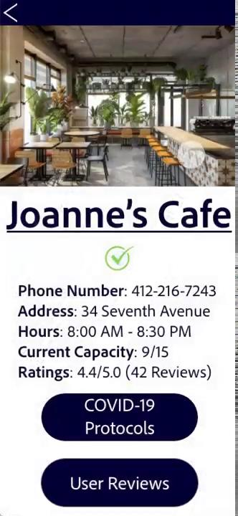
Demonstration
What we noted as possible updates:
Add a filter within the search function so people can find the restaurants based on their preference
Potential to have a “reservation” feature
Even more room for improvement with the aesthetic portion of the app
Still looks fairly generic
More branding
** Please use the video file in the zip file if the video embed does not work **

